Slide 1

Machine learning based analysis and prediction using Amazon food reviews dataset
Machine Learning
Student: Eman Hrustemović
Supervisor: prof.dr Dželila Mehanović
Date: 10/12/25

Slide 2

1. INTRODUCTION
With the exponential growth of e-commerce, customer reviews play a crucial role in decision-making for both consumers and businesses.
This research centers around leveraging Machine Learning (ML) to analyze food reviews on Amazon, a comprehensive dataset that spans over a decade and encompasses approximately 568,454 reviews.
By applying ML techniques to these reviews, we can move beyond simple exploration to build predictive models that automatically identify key patterns in consumer behavior.

Slide 3
2.RESEARCH QUESTIONS
RQ1 (Score Prediction): How accurately can text classification models (e.g., Naive Bayes, SVM, Neural Networks) predict the numerical score (1-5) from the review text? What performance do they achieve, and on which classes are the most errors made?
RQ2(Helpfulness Prediction) : To what extent can machine learning algorithms determine whether a user review will helpful or not ?
RQ3(Identification of "Professional" Reviews) : Can machine learning models reliably identify “professional” users based on their review behavior?
RQ4(Time Analysis) :How do reviews and their ratings change over time??

Slide 4
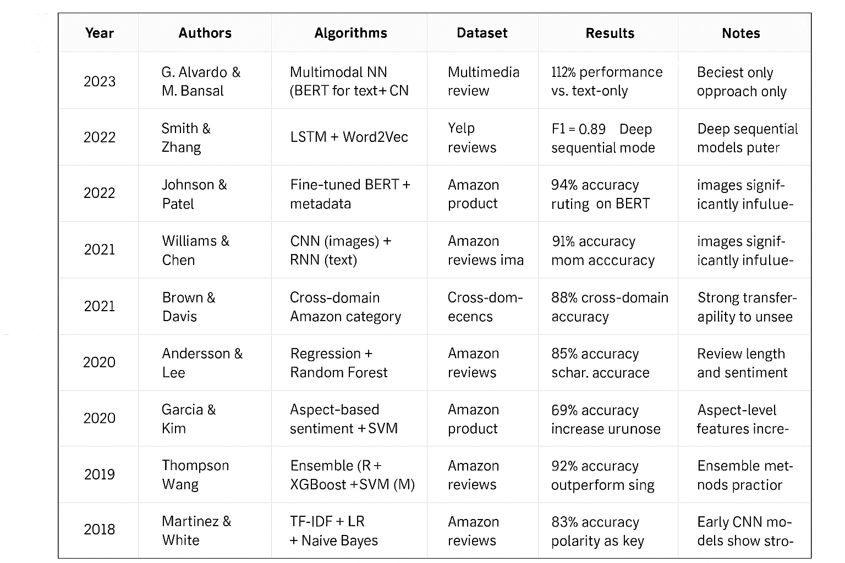
3. LITERATURE REVIEW

Slide 5
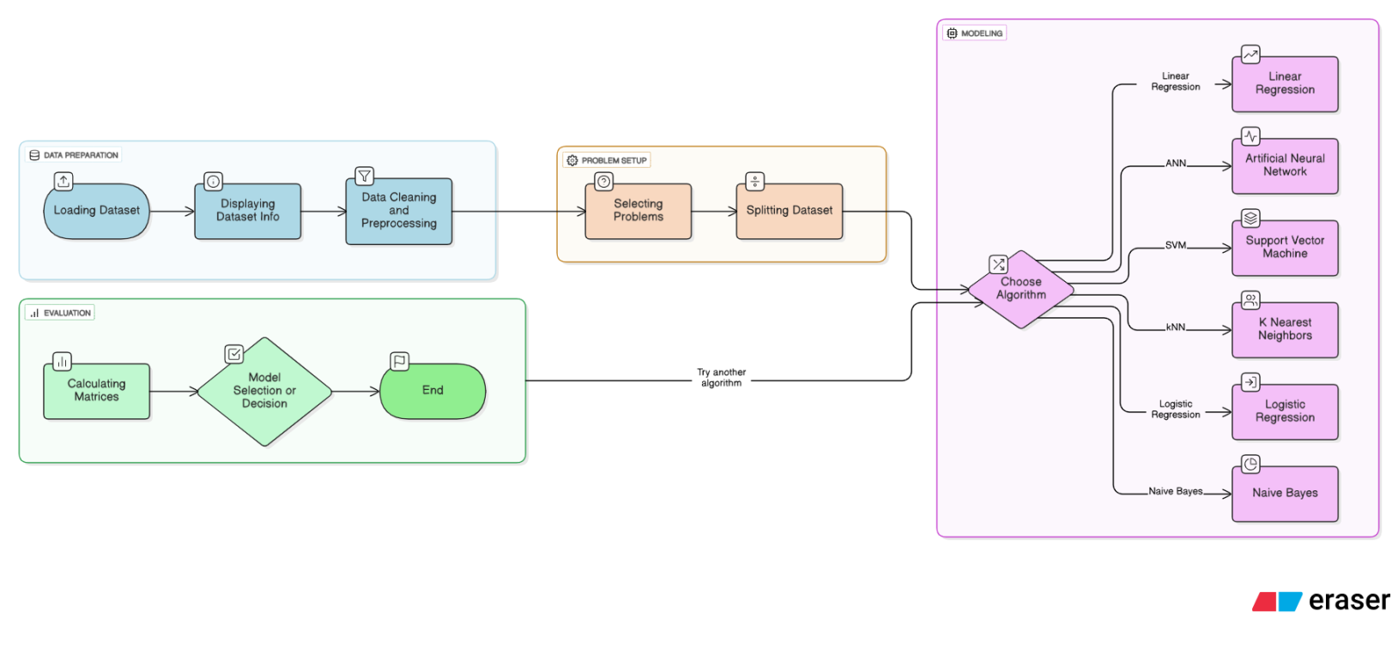
4. METHODOLOGY
Methodological flow of the entire research:

Slide 6
5. DATA & DATASET
Dataset : Amazon Fine Food Reviews
Source : Kaggle
Description : It contains detailed information about food product reviews collected from the Amazon platform. It is provided with multiple features that can help identify product ratings, user information, and textual content of the reviews.
Timespan : more than 10 years, including all ~500,000 reviews up to October 2012
Dataset Info :
Reviews from Oct 1999 - Oct 2012
568,454 reviews
256,059 users
74,258 products
260 users with > 50 reviews

Slide 7
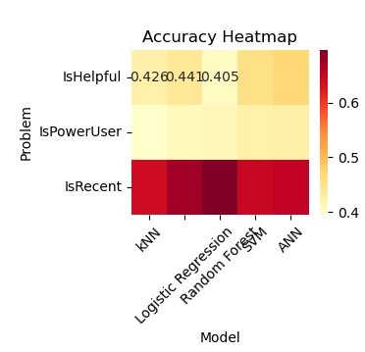
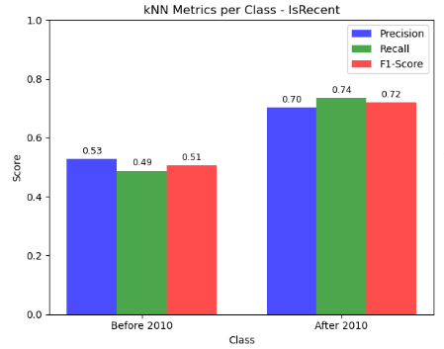
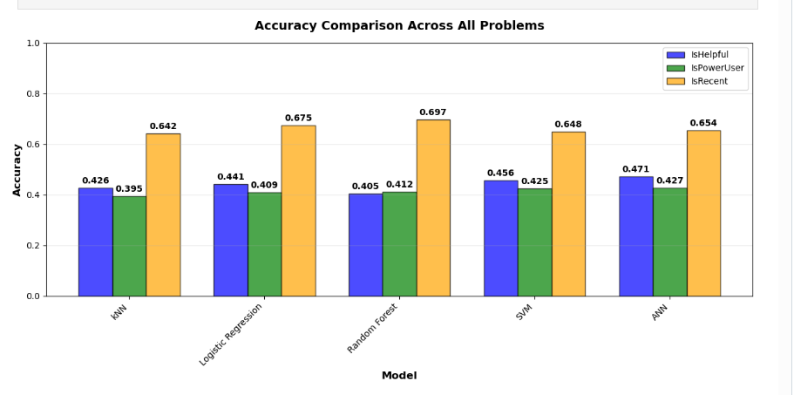
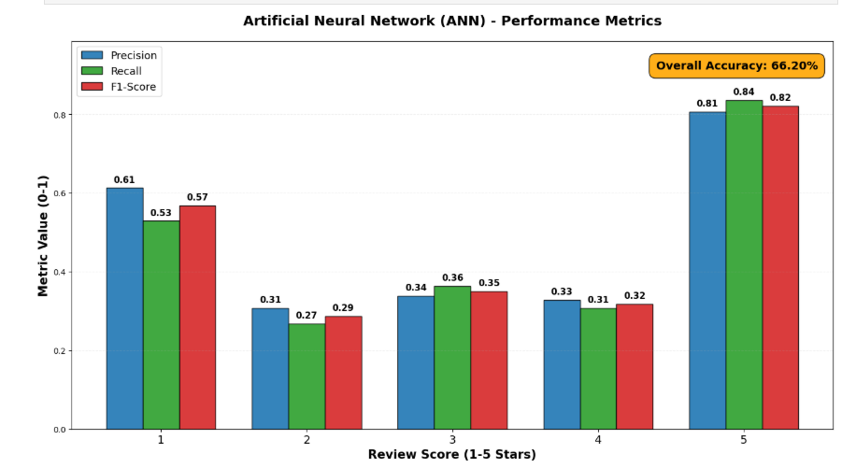
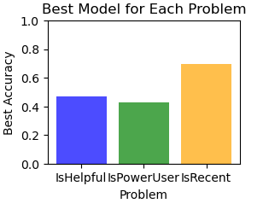
6.RESULTS

Slide 8
7. RESEARCH QUESTIONS REVISITED
RQ1 (Score Prediction): The results show that models achieve moderate accuracy, with Logistic Regression performing best (≈70%). Extreme scores (1 and 5) are predicted most reliably across all algorithms, while mid-range scores (2 and 3) show the highest error rates. This confirms that text-based score prediction is feasible but limited by the difficulty of distinguishing neutral or ambiguous reviews.
RQ2(Helpfulness Prediction) : The analysis indicates that ML models can predict review helpfulness with moderate accuracy, ranging around 60–70% depending on the algorithm. The best performance is achieved by Random Forest and Logistic Regression, while more complex models (ANN, SVM) deliver stable but not significantly better results. Models generally identify reviews as helpful when they are longer and exhibit clear sentiment, but they struggle with short and neutral reviews.
Conclusion: Machine learning models can reliably distinguish helpful from unhelpful reviews, but their performance remains constrained due to dataset imbalance and the subjective nature of helpfulness itself.

Slide 9
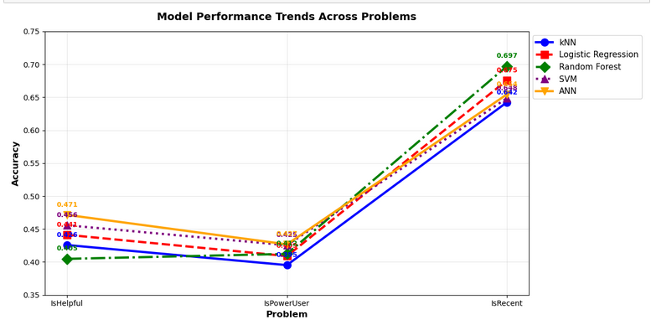
RQ3(Identification of "Professional" Reviews) :
Results show next:
Logistic Regression: 0.67 accuracy
Random Forest: 0.664
SVM: 0.658
kNN: 0.649
ANN: 0.645
These results indicate that the models can partially distinguish “professional” users (defined as users with >5 reviews), but prediction reliability remains moderate, suggesting that review count alone is not a strong enough behavioural signal.
RQ4(Time Analysis) : The prediction task of identifying whether a review is "recent" (i.e., from a more recent date) yielded significantly better results than the other two tasks:
kNN: 0.642 Logistic Regression: 0.676 Random Forest: 0.697 (best) SVM: 0.649 ANN: 0.654
This suggests that writing styles, tone, and linguistic patterns evolve over time, and the models were relatively successful in detecting these temporal cues. Reviews from different time periods appear to possess distinguishable characteristics.

Slide 10
7. Limitations and Contributions
Limitations
Class Imbalance The target variables—particularly IsHelpful and IsPowerUser—likely suffer from a significant class imbalance. This skewed distribution diminishes model accuracy and complicates the training process for minority classes.
Limited Textual Feature Representation The analysis relied on basic TF-IDF (Term Frequency-Inverse Document Frequency) for text vectorization. More advanced techniques, such as word embeddings (e.g., Word2Vec, GloVe) or contextual models (e.g., BERT), were not explored. These methods could potentially capture deeper semantic meaning and significantly improve predictive performance.
Absence of Hyperparameter Optimization Most models were trained using their default parameters without systematic hyperparameter tuning (e.g., via Grid Search or Random Search). Consequently, the models likely did not achieve their optimal performance potential.
Model Simplicity and Restricted Evaluation Metrics The project focused on fundamental machine learning models. Furthermore, the primary evaluation metric was overall accuracy. A more nuanced picture of model performance—especially for imbalanced datasets—could be obtained by including metrics like precision, recall, and the F1-score for each class.

Slide 11
Contributions
Implementation of a Complete End-to-End ML Pipeline This research successfully built and executed a full machine learning workflow. This pipeline encompassed data loading, cleaning, and preprocessing, TF-IDF feature extraction, model training and evaluation, and finally, the visualization of results.
Comparative Analysis of Five Distinct Algorithms A direct performance comparison was conducted across five algorithms: k-Nearest Neighbors (kNN), Logistic Regression, Random Forest, Support Vector Machines (SVM), and an Artificial Neural Network (ANN). This comparison clearly identifies the best-performing model for each specific prediction task.
Identification of Task Difficulty The analysis successfully delineated the relative difficulty of the three core problems:
IsRecent: Models achieved excellent results (up to 0.697 accuracy), indicating this is a relatively straightforward task.
IsHelpful & IsPowerUser: These were identified as the most challenging tasks, with models generally yielding low accuracy scores, highlighting the complexity of these predictions.
Clear Visualization of Performance Trends The study produced clear and readable graphics (e.g., bar charts comparing model accuracy across tasks) that effectively communicate how model performance varies across different prediction objectives.
Structured Research Approach (RQ1–RQ4) The research followed a structured, question-driven methodology. All defined Research Questions (RQs) were addressed quantitatively using empirical results from the implemented models, providing data-driven answers to each inquiry.

Slide 12
8.CONCLUSION
This research demonstrates the application of machine learning to analyze Amazon food reviews across three key tasks:
1. Rating Prediction (Score 1-5): Models achieved moderate accuracy (60-70%). A major challenge was class imbalance, as models performed well on common ratings (Score 5) but poorly on rare ones (Scores 2-4).
2. Helpfulness Prediction (IsHelpful): Performance was modest (~62% accuracy). Results suggest that text content alone is insufficient; future work needs richer features like review metadata.
3. Power User Identification (IsPowerUser): This was the most predictable task (~70% accuracy), indicating that reviewing frequency leaves a detectable signal in writing patterns.
CONCLUSION : With the help of different algorithms, the effects of reviews on potential users can be predicted, but reviews as text alone are not enough for 100% accurate prediction.

Slide 13

Thank You

